Slide 1
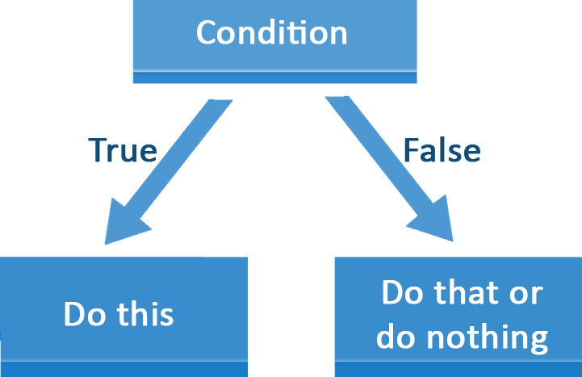
Introduction to PHP
Basic Syntax, Conditional Statements and Loops
SoftUni Team
Technical Trainers
Software University
http://softuni.bg

Slide 2
Table of Contents
Introduction and IDE
Console I/O
var_dump()
Comparison operators
If-else / Switch-case statement
Logical operators
Loops
Debugging and Troubleshooting

Slide 3
Have a Question?
sli.do
#tech-fund

Slide 4


Introduction and IDE

Slide 5
What is PHP?
PHP (PHP Hypertext Preprocessor)
PHP is server-side scripting language for building dynamic Web sites
In order to run our code, we need to tell our IDE that it's PHP code by using the <?php tag before our block of code
Php tag
<?php
echo "Hello, PHP!";
Code

Slide 6
PHP Syntax
The PHP syntax is similar to C#, Java and JavaScript
Operators, Variables, Conditional statements, loops,
functions, arrays, objects and classes.
Declare a variable with $
<?php
$a = 5;
$b = 10;
if ($b > $a) {
echo $b;
}
Conditional statement
Body of the conditional statement

Slide 7

Download, Install and Run XAMPP
XAMPP stands for Cross-Platform (X), Apache (A), MariaDB (M), PHP (P) and Perl (P)
Download XAMPP version 7.2.9 from this link.
Install XAMPP following the instructions in the
XAMPP-Installation-Guide-and-Debugger.docx file

Slide 8
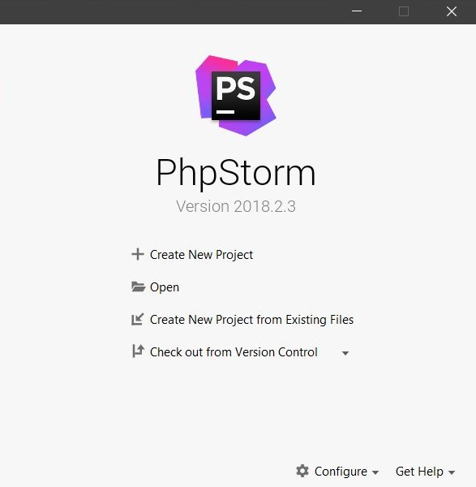
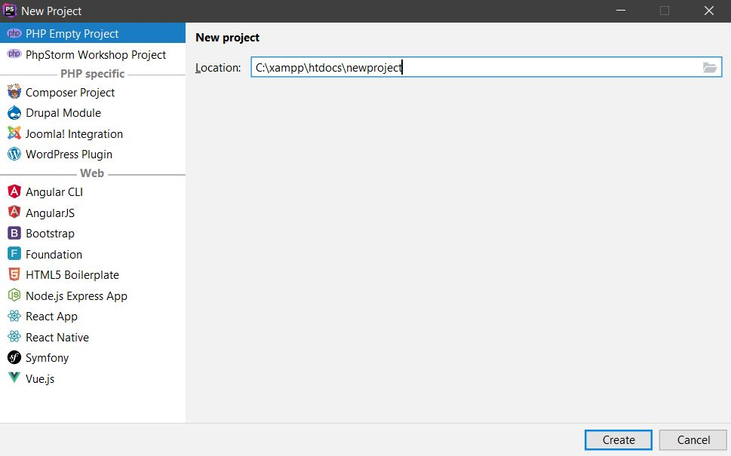
Using PhpStorm
PhpStorm is powerful IDE for PHP and other languages.
Download PHPStorm from here and install with next, next...
Create new project

Slide 9
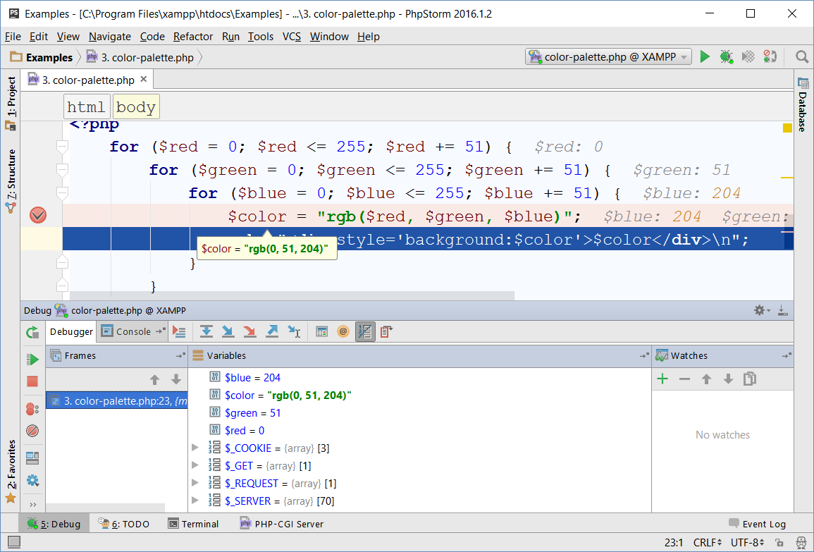
Debugging in PhpStorm
Install Xdebug following the instructions in "XAMPP-Installation-Guide-and-Debugger"
It provides:
Breakpoints
Ability to trace the code execution
Ability to inspect variables at runtime

Slide 10

Console I/O
Reading from and Writing to the Console

Slide 11
Reading from the Console
We can read from the console, using the readline() function
Example:
Read from the console
$name = readline();
$age = intval(readline());
$salary = floatval(readline());
$isHungry = boolval(readline());
Convert the string to another data type

Slide 12
Printing to the Console
Writing output to the console:
Using concatenation
Using interpolation
Concatenate strings
$name = "Peter"; $age = 12; $grade = 5.50
echo 'Name: ' . $name . ', Age: ' . $age . ' . PHP_EOL;
// Name: Peter, Age: 12
Represents new line
Quotes used for interpolation
$name = "Peter"; $age = 12; $grade = 5.50
echo "Name: $name, Age: $age, Grade: $grade";
// Name: Peter, Age: 12, Grade: 5.5
Print to the console

Slide 13
Printing to the Console (2)
Writing output formatted string to the console using printf():
%s - presented as a string
%d - presented as a (signed) decimal number
%f - presented as a floating-point number
formatting to 2 numbers after decimal point
$name = "Peter"; $age = 12; $grade = 5.50
printf('Name: %s, Age: %d, Grade:%.2f',
$name, $age, $grade);
// Name: Peter, Age: 12, Grade: 5.50

Slide 14
Problem: Student Information
Read 3 lines of input – student name, age and average grade
Print all the info about the student
Input
Output
<?php
$name = readline();
$age = readline();
$grade = floatval(readline());
printf( 'Name: %s, Age: %d, Grade: %.2f',
$name, $age, $grade);
Steve
16
2.50
Name: Steve, Age: 16, Grade: 2.50
John
15
5.40
Name: John, Age: 15, Grade: 5.40
Check your solution here: https://judge.softuni.bg/Contests/1191/

Slide 15
string(3) "654"
var_dump()

Slide 16
var_dump()
The var_dump() function is used to display structured information (type and value) about one or more variables.
$integer = 5;
var_dump($integer); // int(5)
var_dump(5.5); // float(5.5)
var_dump("string"); // string(6) "string"
var_dump(true); // bool(true)
var_dump($integer,10,"PHP") // int(5)
// int(10)
// string(3) "PHP"

Slide 17
==
Comparison Operators

Slide 18
Comparison Operators
Operator | Notation in PHP
Equal value Equal value and type | == ===
Not equal value Not equal value and type | != (or <>) !==
Greater than | >
Greater than or Equal | >=
Less than | <
Less than or Equal | <=

Slide 19
Comparison Operators (2)
Parenthesis operator always has the highest precedence
Precedence | Operators
Highest | ^
 | |
 | &&
 | ||
 | ?:
Lower | = *= /= %= += -= <<= >>= &= ^= |=

Slide 20
Operators Precedence
Precedence | Operators
Highest | ()
 | ++ -- (postfix)
 | ++ -- (prefix) + - (unary) !
 | * / %
 | + -
 | << >>
 | < > <= >=
Lower | == !=

Slide 21
Comparing values
$a = 5;
$b = 10;
var_dump($a < $b); // bool(true)
var_dump($a > 100); // bool(false)
var_dump($a < $a); // bool(false)
var_dump($a <= 5); // bool(true)
var_dump($b == 2 * $a); // bool(true)
var_dump($a != $b); // bool(true)

Slide 22

IF
ELSE IF
ELSE
The if-else Statement

Slide 23
The if Statement
The most simple conditional statement
Example: Take as an input a grade and check if the student has passed the exam (grade >= 3.00)
If the condition is met, the code will execute
<?php
$grade = readline();
if ($grade >= 3.00) {
echo "Passed!";
}
Condition body

Slide 24
The if-else Statement
Executes one branch if the condition is true and another, if it is false
Example: Upgrade the last example, so it prints "Failed!", if the mark is lower than 3.00:
if ($a >= 3.00) {
echo "Passed!";
} else {
// TODO: Print the message
}
The else keyword stays on a new line

Slide 25
Problem: Back in 30 Minutes
Write a program that reads hours and minutes from the console and calculates the time after 30 minutes
The hours and the minutes come on separate lines
Examples:
1
46
0
01
23
59
2:16
0:31
0:29
11
08
12
49
11
32
11:38
13:19
12:02
Check your solution here: https://judge.softuni.bg/Contests/1191/

Slide 26
Solution: Back in 30 Minutes
<?php
$hours = readLine();
$minutes = readLine() + 30;
if ($minutes > 59) {
$hours += 1;
$minutes -= 60;
} if ($hours > 23) {
$hours = 0;
}
printf('%d:%02d', $hours, $minutes);
Return a formatted string
Check your solution here: https://judge.softuni.bg/Contests/1191/

Slide 27
switch() {
case :
}
The switch-case Statement

Slide 28
The switch-case Statement
Works as sequence of if-else statements
Example: read input a number and print its corresponding month:
$month = intval(readLine());
switch ($month) {
case 1: echo "January"; break;
// TODO: Add the other cases
default: echo "Error!"; break;
}

Slide 29
Advanced switching: Condition cases
PHP's switch doesn't just allow you to switch on the value of a particular variable. You can use any expression as one of the cases, as long as it gives a value for the case to use
switch(true) {
case (strlen($foo) > 30):
$error = "The value provided is too long.";
$valid = false; break;
case (strlen($foo) < 3):
$error = "The value provided is too short.";
$valid = false; break;
default:
$valid = true; break;
}

Slide 30

Problem: Foreign Languages
By given country print its typical language:
English -> England, USA
Spanish -> Spain, Argentina, Mexico
other -> unknown
England
English
Spain
Spanish
Check your solution here: https://judge.softuni.bg/Contests/1191/

Slide 31
Solution: Foreign Languages
//TODO: Read the input
switch ($country) {
case "USA":
case "England": echo "English"; break;
case "Spain":
case "Argentina":
case "Mexico": echo "Spanish"; break;
default: echo "unknown"; break;
}
Continues until it finds break
Check your solution here: https://judge.softuni.bg/Contests/1191/

Slide 32
&&
Logical Operators
Writing More Complex Conditions

Slide 33
Logical Operators
Logical operators give us the ability to write
multiple conditions in one if statement
They return a boolean value
Operator | Notation in PHP | Example
Logical NOT | ! | !false -> true
Logical AND | &&, and | true && false -> false
Logical OR | ||, or | true || false -> true
Logical XOR | xor | true xor true -> false

Slide 34
Problem: Theatre Promotions
A theatre has the following ticket prices according to the age of the visitor and the type of day. If the age is < 0 or > 122, print "Error!":
Day / Age | 0 <= age <= 18 | 18 < age <= 64 | 64 < age <= 122
Weekday | 12$ | 18$ | 12$
Weekend | 15$ | 20$ | 15$
Holiday | 5$ | 12$ | 10$
Weekday
42
Holiday
-12
18$
Error!
Check your solution here: https://judge.softuni.bg/Contests/1191/

Slide 35
Solution: Theatre Promotions
$day = intval(readline());
$age = intval(readline());
$price = 0;
if ($day == "Weekday") {
if (($age >= 0 && $age <= 18) || ($age > 64 && $age <= 122)){
$price = 12;
} // TODO: Add else statement for the other group
}
// Continues on the next slide
Check your solution here: https://judge.softuni.bg/Contests/1191/

Slide 36
Solution: Theatre Promotions (2)
else if ($day == "Weekend") {
if (($age >= 0 && $age <= 18) || ($age > 64 && $age <= 122)) {
$price = 15;
} else if ($age > 18 && $age <= 64) {
$price = 20;
}
} // Continues on the next slide
Check your solution here: https://judge.softuni.bg/Contests/1191/

Slide 37
Solution: Theatre Promotions (3)
else if ($day == "Holiday") {
if ($age >= 0 && $age <= 18) {
$price = 5;
}// TODO: Add the statements for the other cases
}
if ($price != 0)
echo $price . "$";
else
echo "Error!";
Check your solution here: https://judge.softuni.bg/Contests/1191/

Slide 38

Loops

Slide 39
What are loops
The for loop:
Execute a code block a fixed number of times:
The while/do-while loop:
Executes code while a given condition returns true
<?php
for ($i = 1; $i <= 5; $i++)
echo $i . PHP_EOL;
Incrementation in the condition
<?php
$i = 1;
while ($i <= 5)
echo $i++ . PHP_EOL;
Incrementation outside the condition

Slide 40
For-Loops
The for loop executes statements a fixed number of times:
Initial value
End value
Operation
for($i = 1; $i <= 10; $i++) {
echo "i = " . $i;
}
Loop body
Executed at each iteration

Slide 41
Problem: Sum of Odd Numbers
Write a program to print the first n odd numbers and their sum
<?php
$n = intval(readline()); $sum = 0;
for ($i = 1; $i <= $n; $i++) {
$currentOdd = 2 * $i - 1;
echo $currentOdd . PHP_EOL;
$sum += $currentOdd;
}
echo "Sum: " . $sum;
1
3
5
7
9
Sum: 25
5
Check your solution here: https://judge.softuni.bg/Contests/1191/

Slide 42
While Loops
Executes commands while the condition is true:
$n = 1;
while ($n <= 10) {
echo $n;
$n++;
}
Condition
Increment the counter
Loop body

Slide 43
Problem: Multiplication Table
Print a table holding number*1, number*2, …, number*10
<?php
$number = intval(readLine());
$times = 1;
while ($times <= 10) {
echo "{$number} X {$times} = "
. $number * $times . PHP_EOL;
$times++;
}
Check your solution here: https://judge.softuni.bg/Contests/1191/

Slide 44
Do ... While Loop
Similar to the while loop, but always executes at least once:
$i = 1;
do {
echo $i;
$i++;
} while ($i <= 10);
Initial value
Increment the counter
Loop body
Condition

Slide 45
Problem: Multiplication Table 2.0
Upgrade your program and take the initial times from the console
<?php
$number = intval(readline());
$times = intval(readline());
do {
echo $number . " X " . $times . " = " . $number * $times . PHP_EOL;
$times++;
} while ($times <= 10);
Check your solution here: https://judge.softuni.bg/Contests/1191/

Slide 46

Debugging the Code
Using Xdebug

Slide 47

Debugging the Code
The process of debugging application includes:
Spotting an error
Finding the lines of code that cause the error
Fixing the error in the code
Testing to check if the error is gone and no new errors are introduced
Iterative and continuous process

Slide 48

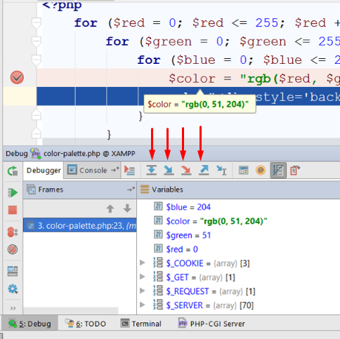
Using the Debugger in PhpStorm
Start without Debugger: [Shift+F10]
Toggle a breakpoint: [Shift+F9]
Trace step by step: [F7]
Force step into: [Alt+Shift+f7]
Using the Local
Conditional breakpoints
Enter debug mode after exception

Slide 49
Problem: Price Change Alert
Rework a given piece of code which is not properly formatted.
The given program tracks stock prices and gives updates about the significance in each price change. There are four kind of changes:
No change at all (price is equal to the previous)
Minor (difference is below the significance threshold)
Price up
Price down
Download the broken code here: https://judge.softuni.bg/Contests/1191/

Slide 50

Live Exercises

Slide 51

Summary
Declaring Variables
Reading from / Printing to the Console
Conditional Statements allow implementing programming logic
Loops repeat code block multiple times
Using the debugger
…
…
…

Slide 52
https://softuni.bg/courses/technology-fundamentals

Slide 53













SoftUni Diamond Partners

Slide 54





SoftUni Organizational Partners

Slide 55




Trainings @ Software University (SoftUni)
Software University – High-Quality Education and Employment Opportunities
softuni.bg
Software University Foundation
http://softuni.foundation/
Software University @ Facebook
facebook.com/SoftwareUniversity
Software University Forums
forum.softuni.bg

Slide 56

License
This course (slides, examples, demos, videos, homework, etc.) is licensed under the "Creative Commons Attribution-NonCommercial-ShareAlike 4.0 International" license

